Slide 1
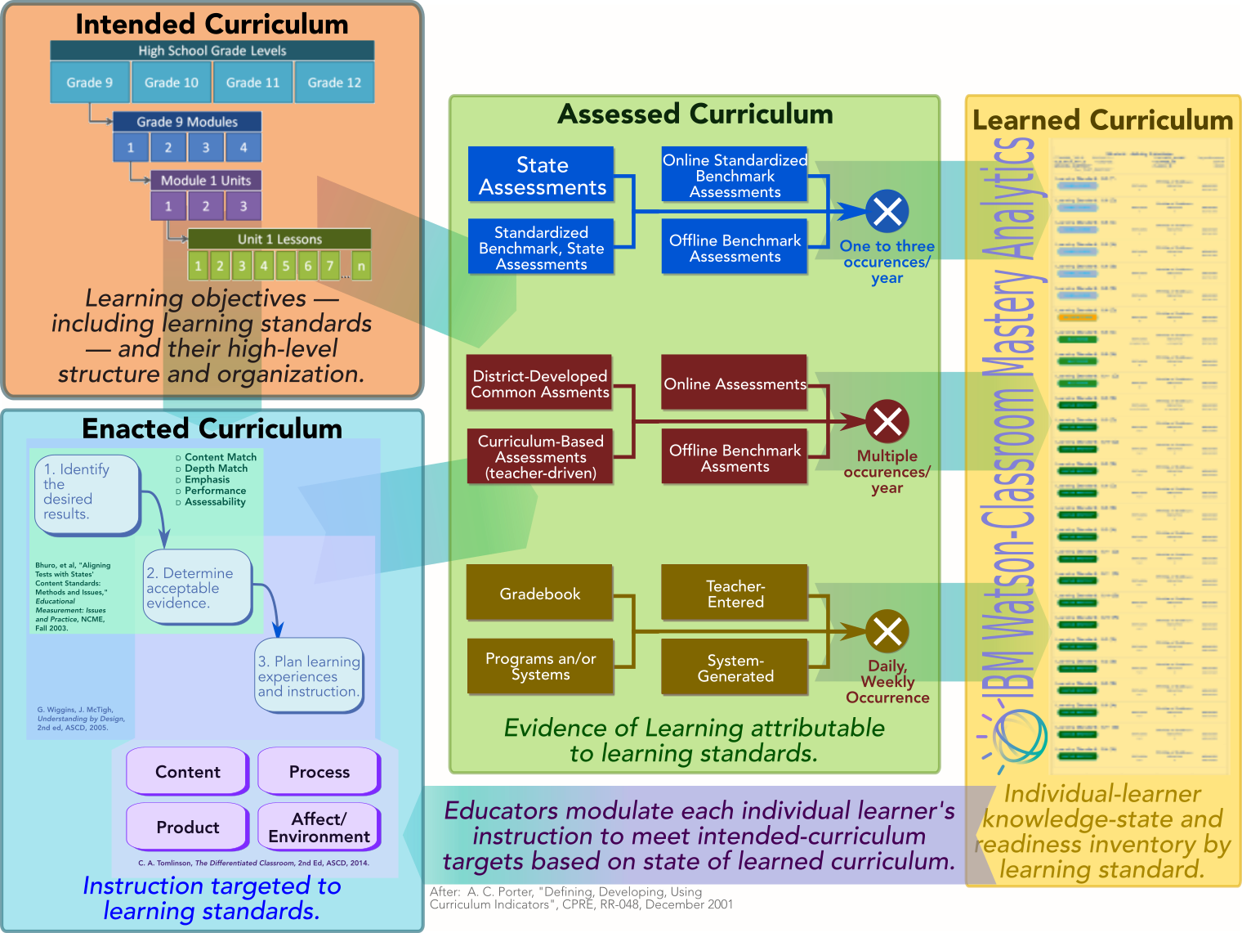
Data required for Watson Mastery answer the key question, “How are my learners performing against the prescribed curriculum?”
Standards-aligned evidence of learning.
Policies, preferences for imputing learners’ state of knowledge based on proficiency measurements
What the Mastery algorithm produces.
Learning-standards baseline.
Learning-standards progressions.
Course blueprints/curriculum maps.
Learning-standards version migration.
Teacher units.
Course enrollment.
Course-section teaching assignments.
Instructional content aligned to intended curriculum.
Instructional guides, lesson plans, formative-assessment examples.

Slide 2
Mastery-Essential Watson Education-Data Cloud entities (tables) by Curriculum-Alignment Component.
Information Element | Questions Answered? | Watson Education Data Cloud Tables |  | Source
Intended Curriculum.
Course Blueprint. | What is the learning-standard scope of the course of interest? | COURSE_LEARNING_STD_MAP |  | Curriculum-digitization Tooling
Learning standard. | What specific pieces of knowledge are students are expected to acquire? | SIHLEARNING_ STANDARD SIHSTANDARD_ CONTENT | SIHLEARNING_STANDARD_HIERARCHY SIHSTANDARD_JURISDICTION | Learning-standards curator (e.g, EdGate, Certica). Curriculum-digitization Tooling
Learning-standards vertical articulation (aka, “progressions”). | How does one piece of knowledge build on the other as students progress through the curriculum? |  |  | IBM-retained consultants (e.g., K. Hess) Third-parties (e.g., NGSS, Lead4Ward) State Education Agencies (NY) Curriculum-digitization Tooling
Enacted Curriculum.
Course enrollment. | Which students are enrolled in an academic course of interest? | SIHCOURSE COURSE_SECTION | COURSE_SECTION_STUDENT COURSE_SECTION_STAFF | Student-Information System
Personal Identifying Information |  | SIHPERSON | SIHORGPERSONROLE
Organizational Information |  | SIHORG |  | Client-setup, -configuration tooling
Course instructional plan |  | TEACHER_UNIT | CRS_SCTN_TCHR_UNT_LRGN_STD | Curriculum-digitization Tooling
Assessed Curriculum.
Standards-aligned evidence of learning. | What is the measured state of knowledge of learning standards in the vertical articulations by enrolled students? | EVIDENCE_OF_ LEARNING WORK_PRODUCT | WRK_PRDCT_LRNG_STD | Assessment-data systems (Eduphoria, Edugence). State Education Agencies (TX STAAR, NY. Third-party learning systems (iReady, Pearson Envision, Wonders). Digital gradebooks from Some Student-Information System, Learning-Management Systems. Input via Watson-education user interface
Evidence-of-learning interpretation. | What do observed evidence of learning say about students strength of mastery of specific learning standards? | MASTERY_COLOR_LIST | MASTERY_WEIGHTS | Client-setup, -configuration tooling
Learned Curriculum.
Imputed (“measured”) knowledge states and estimated readiness states. | What are the measured knowledge state and estimated readiness state for each student with respect to each learning standard? | STUDENT_KNOWLEDGE_LEVEL |  | Algorithm-Generated
Learning-standard progression conditional-probability relationships. | How does an imputed knowledge state for prerequisite learning standards influence my belief for what is taught next? | CPT_LONG |  | Algorithm-Generated

Slide 3
Information Elements by Curriculum-Alignment Component.
Information Element | Questions Answered? | Typical Source | Comments
Intended Curriculum.
Course Blueprint. | What is the learning-standard scope of the course of interest? | Curriculum-alignment tool in Watson-Education. Third-party curriculum-mapping tool.
Learning standard. | What specific pieces of knowledge are students are expected to acquire? | Learning-standards curator (e.g., Certica Solutions) for state-promulgated learning standards. Watson-Education Learning-Standard definition tool (planned).
Learning-standards vertical articulation (aka, “progressions”). | How does one piece of knowledge build on the other as students progress through the curriculum? | Recognized education experts (Hess, MacLean-Alfonso for CCSS). Learning-standards publishers (NGSS). State Education Agencies (TEA, NYBoE). Third-party curriculum advisors (Lead4Ward). Watson-Education Learning-standard vertical-articulation tool (planned).
Enacted Curriculum.
Course enrollment. | Which students are enrolled in an academic course of interest? | Student-Information System.
Assessed Curriculum
Standards-aligned evidence of learning. | What is the measured state of knowledge of learning standards in the vertical articulations by enrolled students? | Assessment-data systems (Eduphoria, Edugence). State Education Agencies (TX STAAR, NY. Third-party learning systems (iReady, Pearson Envision, Wonders). Learning-management systems. Watson-classroom, –element application interfaces.
Evidence-of-learning interpretation. | What do observed evidence of learning say about students strength of mastery of specific learning standards? | Watson-Classroom mastery-configuration tool (planned). | MASTERY_COLOR_LIST MASTERY_WEIGHTS

Slide 4
Minimum Data-Dictionary.
Information Entity | Information Attributes |  | Typical Source | Comments
Intended Curriculum.
Course Blueprint. | Course ID | Learning Standard ID | Third-party curriculum-mapping tool Lightweight Watson-Education curriculum-mapping tool
Learning standard. | Learning-standard ID Learning-Standard Code Academic Subject Area | Learning-standard Text Jurisdiction ID | Learning-standards curator (e.g., Certica, Edgate) for state learning standards. Lightweight Watson-Education curriculum-definition tool.
Learning-standards vertical articulation (aka, “progressions”). | Prerequisite learning standard ID | Target learning standard ID
Learning-Standard Hierarchy | Learning Standard ID | Composite Learning Standard ID
Course enrollment. | Student ID Tenant ID | Course ID | Student-Information System
Standards-aligned evidence of learning. | Student ID Learning Standard ID Evidence of Learning Source Evidence of Learning Score | Assessment Date Assessment Source Evidence of Learning Source (key for weighting) Scoring approach Tenant ID | Assessment-data systems (Eduphoria, Edugence). State Education Agencies (TX STAAR, NY. Third-party learning systems (iReady, Pearson Envision, Wonders). Digital gradebooks from Some Student-Information System, Learning-Management Systems.
Evidence-of-learning interpretation. | Scoring approach Mastery categories | Score-to-category criteria Tenant ID |  | MASTERY_COLOR_LIST in today’s data schema. Clients have asked for more-granular differentiation, including campus-level, subject/grade-level We currently assign to categories based on 0-100 scoring approach. Not all clients do this.
Evidence-of-learning aggregation weight | Tenant ID | Evidence of learning source Evidence of learning weight |  | MASTERY_WEIGHTS Clients have asked for more-granular differentiation, including campus-level, subject/grade-level

Slide 5
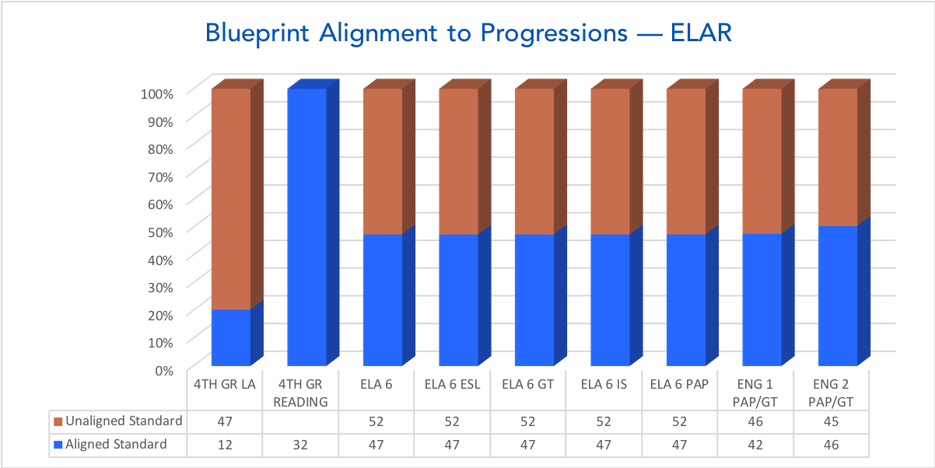
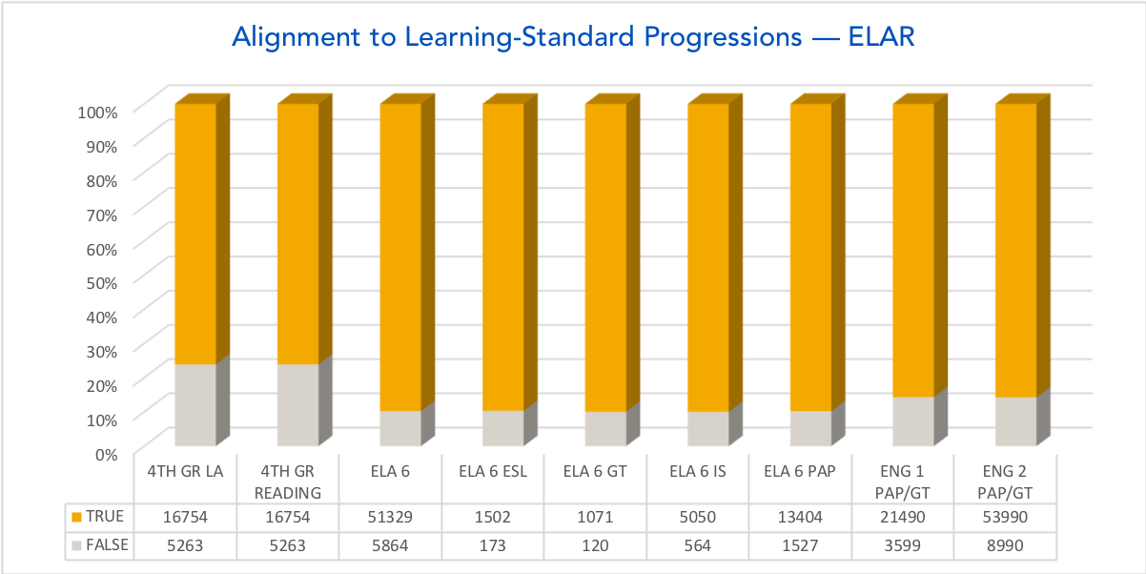
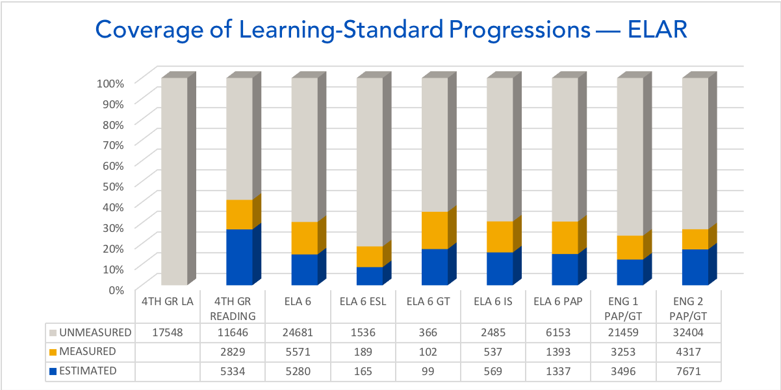
Watson-education users’ expectations can be calibrated if they understand the extent of alignment of their curricula.

